Slide 1


<Name>
<Date>

Slide 2

Outline
Executive Summary
Introduction
Methodology
Results
Conclusion
Appendix

Slide 3
Executive Summary
SpaceX launch data was collected using the SpaceX REST API and web scraping (BeautifulSoup).
Exploratory data analysis included interactive Folium maps showing launch outcomes by site, and Plotly dashboardsfor payload success rates and feature correlations.
Four classification models were built—Logistic Regression, SVM, Decision Tree, and KNN—and fine-tuned using GridSearchCV with 10-fold cross-validation.
The Decision Tree achieved the highest CV accuracy, though test accuracy was consistent (~83%) across all models.
Confusion matrices highlighted false positives as a key area for improvement.
Key predictors of launch success included payload mass and launch site.

Slide 4
Introduction
Our competitor Space X is unique in the industry where it can recover and reuse one of its rockets (Falcon9) if it successfully lands.
Our company would like to compete with SpaceX and we’d like to determine the price of each launch. Using SpaceX’s Falcon9 data, we’re able to estimate the price of each launch along with determining if SpaceX can reuse the first stage.

Slide 5

Section 1

Slide 6
Methodology
Executive Summary
Data collection methodology:
Used the SpaceX REST API endpoints extracting JSON objects
Web scrapping related wiki pages using Python Beautiful Soup
Perform data wrangling
Using the data from SpaceX REST API, performed some exploratory data analysis
Created a training label for successful/unsuccessful landing
Identification of missing values, where only LandingPad seem to be missing.
Perform exploratory data analysis (EDA) using visualization and SQL
Perform interactive visual analytics using Folium and Plotly Dash
Perform predictive analysis using classification models
How to build, tune, evaluate classification models
Notes:
Develop Python code to manipulate data in a Pandas data frame
Convert a JSON file into a Create a Python Pandas data frame by converting a JSON file
Create a Jupyter notebook and make it sharable using GitHub
Utilize data science methodologies to define and formulate a real-world business problem
Utilize your data analysis tools to load a dataset, clean it, and find out interesting insights from it

Slide 7
Data Collection
Data collection involves using two sources:
SpaceX launch data gathered from an API specifically the SpaceX REST API. This API will give us data about launches, including information about the rocket used, payload delivered, launch specifications, landing specifications, and landing outcome
Additional data is extracted from SpaceX Wikipedia page using BeautifulSoup package

Slide 8
Data Collection – SpaceX API
Requesting rocket launch data from SpaceX API
Append additional columns using different end-point data
Convert JSON objects to dataframe using json_normalize()
Obtain response in the form of JSON objects using .json()
Construct dataset and combine into dictionary
Create pandas dataframe from dictionary
Filter for Falcon 9 launches
Using SpaceX REST API – collect relevant rocket launch data and transform into Pandas dataframe following the process below:
Link: https://github.com/camfarrell25/IBM-Capstone-Project-CF2025/blob/main/1_jupyter-labs-spacex-data-collection-api-v2.ipynb

Slide 9
Data Collection – Webscrapping
Based on SpaceX Wikipedia page, use BeautifulSoup to extract launch data to supplement our analysis, as follows:
Create BeautifulSoup object from HTML response from Wikipedia Page
Convert dictionary to Pandas dataframe
Create dictionary of relevant columns and fill data with the appropriate keys from the parsed HTML data
Find all tables using BeautifulSoup and identify the table containing launch data
Link: https://github.com/camfarrell25/IBM-Capstone-Project-CF2025/blob/main/2_jupyter-labs-webscraping.ipynb

Slide 10
Data Wrangling
SpaceX REST API Data:
Missing Data Treatment:
Missing Payloadmass to be replace mean value of Payloadmass
Missing LandingPad data are not replaced
Calculate number and occurrence of each orbit along with outcome
Create binary variable for successful outcome and calculate success rate
Missing Data Treatment – Identify missing data and for Payloadmass, replace with mean value of Payloadmass for all observations (missing LandingPad datapoints are not replaced)
Calculate number and occurrence of each orbit, and outcome
Create binary variable for successful outcome
Calculate success rate
Link: https://github.com/camfarrell25/IBM-Capstone-Project-CF2025/blob/main/3_labs-jupyter-spacex-Data%20wrangling-v2.ipynb
Notes:
Describe how data were processed
You need to present your data wrangling process using key phrases and flowcharts
Add the GitHub URL of your completed data wrangling related notebooks, as an external reference and peer-review purpose

Slide 11
EDA with Data Visualization
Summary of charts:
Scatter plot of launch outcome, flight Number, and pay Load Mass (kg) – to see the correlation between outcome and flight number and pay load mass
Scatter of plot of launch outcome, flight number and launch site – to visualize the correlation between success rate, and launch site
Scatter plot of launch outcome, launch site, and pay load mass – to visualize the correlation between success rate, launch site, along with payload mass
Bar chart of success rate and orbit type – to visualize relationship between success rate and orbit type
Scatter plot of launch outcome, orbit, and flight number – to visualize the relationship between Orbit, Flight number and overlayed with outcome
Scatter plot of launch outcome, orbit, and pay load mass – to visualize how success rates vary for different combinations of orbit and pay load mass.
Line chart of average success rate yearly trend - to determine how the average success rate has varied over the years
Link: https://github.com/camfarrell25/IBM-Capstone-Project-CF2025/blob/main/3_labs-jupyter-spacex-Data%20wrangling-v2.ipynb

Slide 12
EDA with SQL
Below are a list of SQL queries performed:
Retrieve a list of distinct launch sites with no filters applied.
List launch sites that begin with "CCA", limited to 5 results by filtering for launch site names starting with 'CCA'.
Calculate the total payload mass for missions where the customer is NASA (CRS).
Compute the average payload mass for missions using the F9 v1.0 booster version.
Find missions launched from 'CCAFS LC-40' with payloads over 4000 kg that successfully landed on a drone ship.
(Similar to above) List mission details with the same filters: 'CCAFS LC-40', payloads over 4000 kg, and successful drone ship landings.
(Similar to above) Another variation of the same filtered mission query.
Find the maximum payload mass among missions with successful drone ship landings.
Retrieve booster version and landing outcome for missions using the F9 B4 booster version through a join query.
Count the number of successful drone ship landings, grouped by booster version.
GitHub Link: https://github.com/camfarrell25/IBM-Capstone-Project-CF2025/blob/main/4_jupyter-labs-eda-sql-coursera_sqllite.ipynb

Slide 13
Build an Interactive Map with Folium
Summarize what map objects such as markers, circles, lines, etc. you created and added to a folium map
We’ve created the following objects:
Map object, with an initial center location to be NASA Johnson Space Center at Houston, Texas
Circle area with a text label on series of coordinates, including the NASA Space Center and each of the launch sites
Markers for all launch records, where if a launch was successful, we use a market marker, otherwise a red marker. We did that by using a MarkerCluster object for the multiple launches per site.
MousePosition object for a mouseover point on the map in order to be able to easily find the coordinates of any points of interests
We’ve added a distance marker and polylines between one of the launch site and the nearest points of interests including coastlines, highways, and railways.
GitHub Link: https://github.com/camfarrell25/IBM-Capstone-Project-CF2025/blob/main/6_lab-jupyter-launch-site-location-v2.ipynb#:~:text=6_lab-,%2D,-jupyter%2Dlaunch%2Dsite

Slide 14
Build a Dashboard with Plotly Dash
Summary of Plots, Graphs, and Interactions Added to the Dashboard
Launch Site Dropdown
A dropdown menu allowing users to select either All Sites or a specific launch site.
This input controls what data is displayed in the visualizations.
Success Pie Chart
When All Sites is selected, shows the total successful launches by each launch site as a pie chart.
When a specific site is selected, shows the success vs failure counts (class 1 vs 0) for that site.
Interactive: Updates dynamically when the dropdown selection changes.
Payload Mass Range Slider
A slider allowing users to select a range of payload mass (in kg).
Controls the filtering of launch data shown in the scatter plot.
Payload vs Launch Success Scatter Plot
Shows the relationship between payload mass and launch success.
Points are colored by Booster Version Category for added insight.
Updates dynamically based on both the launch site dropdown and payload slider selections,
Why These Plots and Interactions Were Added
Launch Site Dropdown enables focused analysis of specific launch sites or an overview of all sites, providing flexibility to users.
The Pie Chart succinctly communicates the success rate distribution:
Aggregated success counts help identify the best-performing launch sites.
Per-site success/failure breakdown helps assess individual site reliability.
The Payload Slider introduces an interactive way to filter the data by payload weight, which is a critical factor influencing launch outcomes.
The Scatter Plot illustrates the correlation between payload mass and launch success, revealing patterns or anomalies.
Coloring by booster version adds a layer to understand if certain booster types influence success rates.
Together, these interactions allow users to explore and drill down into the SpaceX launch data to uncover insights about success rates across sites and payload characteristics.
GitHub Link: /Users/camillefarrell/Documents/Python/Capstone Project/7_labsjupyter_plotlydash.ipynb

Slide 15
Predictive Analysis (Classification)
We prepared and standardized the data, then split it into training and test sets. We built four classification models—Logistic Regression, SVM, Decision Tree, and KNN—and tuned them with GridSearchCV using 10-fold cross-validation. All models showed similar accuracy, indicating a well-structured dataset. Next, we plan to improve performance by exploring ensemble methods and feature engineering.
Data Prep: cleaned the data, extracted features and target, standardized features
Data Split: Training (80%) and testing (20%) sets with fixed random seed
Modeling: Built logistic regression, SVM, Decision Tree, and KNN models. Used GridSearchCV (10-fold CV) for hyperparameter tuning
Evaluation: Compared models using CV accuracy, test accuracy, confusion matrices, and classification reports
Results: Models showed similar strong performance on this dataset
Model Selection: Tree model seemed to yield higher best score, although the margin between other alternatives was minimal
Next steps: Explore ensemble methods and feature engineering for further improvements.
GitHub Link: https://github.com/camfarrell25/IBM-Capstone-Project-CF2025/blob/main/7_SpaceX-Machine-Learning-Prediction-Part-5-v1.ipynb
Notes:
https://github.com/camfarrell25/IBM-Capstone-Project-CF2025/blob/main/7_SpaceX-Machine-Learning-Prediction-Part-5-v1.ipynb

Slide 16
Results
1. Exploratory Data Analysis (EDA)
Examined data distributions and identified key patterns
Visualized correlations and class balances
Found [mention any important insights, e.g., feature correlations or imbalances]
2. Interactive Analytics Demo
Developed interactive maps and dashboards for launch site proximity analysis
Visualized distances to coastline, railway, highway with live markers and distance labels
Enabled dynamic exploration of SpaceX launch sites and infrastructure
3. Predictive Analysis Results
Built and tuned Logistic Regression, SVM, Decision Tree, and KNN classifiers using GridSearchCV
All models achieved similar cross-validation and test accuracies (~[insert your accuracy, e.g., 85%])
Confusion matrices showed low false positives and false negatives
Best performing model identified based on cross-validation accuracy and detailed evaluation metrics

Slide 17

Section 2

Slide 18
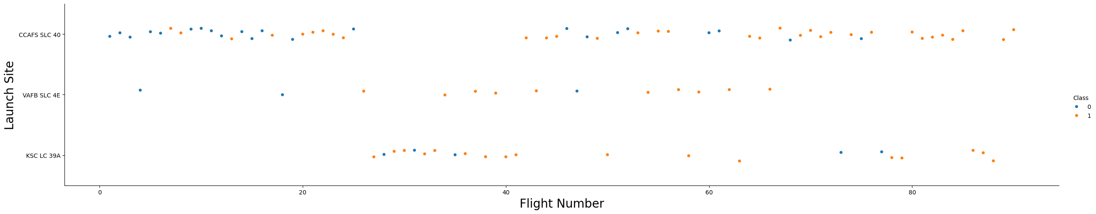
Flight Number vs. Launch Site
Below are some of the patterns found in the Flight Number vs Launch Site scatter:
1. CCAFS SLC 40: This launch site has a mix of successful and unsuccessful launches. As the flight number increases, the success rate improves, suggesting that SpaceX's experience and improvements over time have positively impacted launch outcomes.
2. VAFB SLC 4E: This site has fewer launches compared to CCAFS SLC 40. The launch site shows increased success rate, especially amongst higher flight numbers
3. KSC LC 39A: This site shows a higher success rate even for lower flight numbers. It suggests that this site might be used for more critical or well-prepared missions, leading to better outcomes.
Overall, the plot indicates that SpaceX's success rate improves with experience (higher flight numbers) and that launch site characteristics or mission types may influence outcomes.

Slide 19
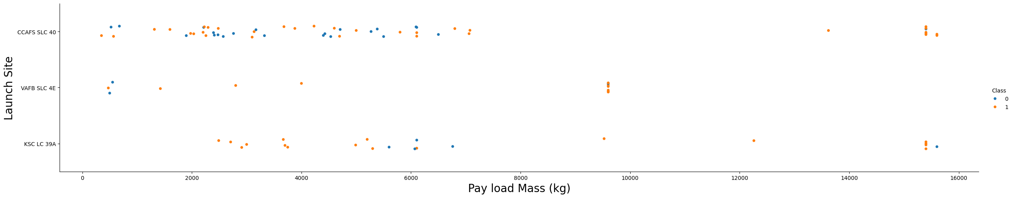
Payload vs. Launch Site
The scatter plot illustrates the relationship between Payload Mass, Launch Site, and Outcome (success or failure) of SpaceX launches.
Key Observations:
1. CCAFS SLC 40:
Handles a wide range of payload masses.
Mixed outcomes, with both successful and unsuccessful launches.
2. KSC LC 39A:
Primarily successful launches, even with heavier payloads.
Indicates reliability for critical missions.
3. VAFB SLC 4E:
Limited launches, mostly lighter payloads.
Higher success rate for its missions.
Key Insights:
Heavier payloads are more likely to succeed at KSC LC 39A.
CCAFS SLC 40 shows variability in outcomes, suggesting room for optimization.
Launch site characteristics and payload mass significantly influence mission success.

Slide 20
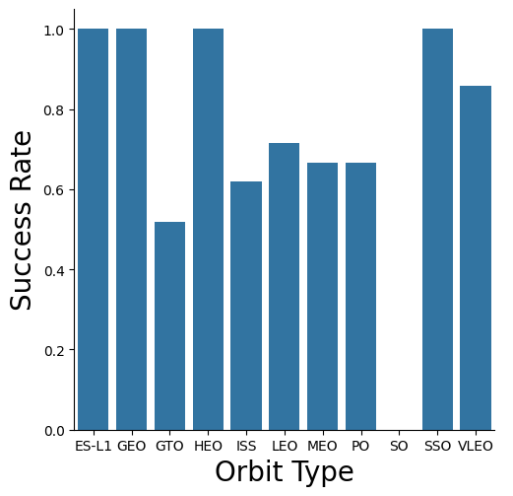
Success Rate vs. Orbit Type
The bar chart illustrates the success rate of SpaceX launches across different orbit types. Each bar represents the average success rate for a specific orbit, calculated as the proportion of successful launches.
Key Observations:
1. High Success Rates:
Orbits such as ES-L1, GEO, HEO, and SSO exhibit a 100% success rate, indicating consistent reliability for missions targeting these orbits.
2. Moderate Success Rates:
Orbits like LEO (Low Earth Orbit) and ISS (International Space Station) show relatively high success rates, reflecting SpaceX's extensive experience and optimization for these commonly used orbits.
3. Low Success Rates:
- The SO (Solar Orbit) has a 0% success rate, highlighting challenges or limited data for missions targeting this orbit.
Insights:
The chart demonstrates SpaceX's ability to achieve high reliability for specific orbits, particularly those with frequent launches.
It also highlights areas for potential improvement, such as orbits with lower success rates.
This analysis provides valuable insights into SpaceX's performance across different mission profiles, helping guide future optimizations and mission planning.

Slide 21
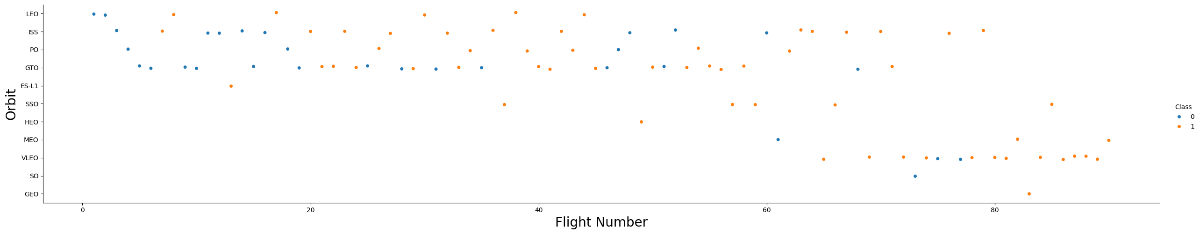
Flight Number vs. Orbit Type
The scatter plot visualizing Flight Number vs. Orbit highlights the relationship between the number of launches and their respective orbits.
Key observations include:
1. LEO (Low Earth Orbit):
Success rates improve with higher flight numbers, indicating that SpaceX's experience positively impacts mission outcomes in this orbit.
2. GTO (Geostationary Transfer Orbit):
No clear relationship between flight number and success rate, suggesting challenges specific to this orbit.
3. Other Orbits:
Limited data points, but success appears consistent for certain orbits like Polar and ISS.
Overall, the plot demonstrates that experience (higher flight numbers) correlates with improved success in some orbits, while others may require further optimization.

Slide 22
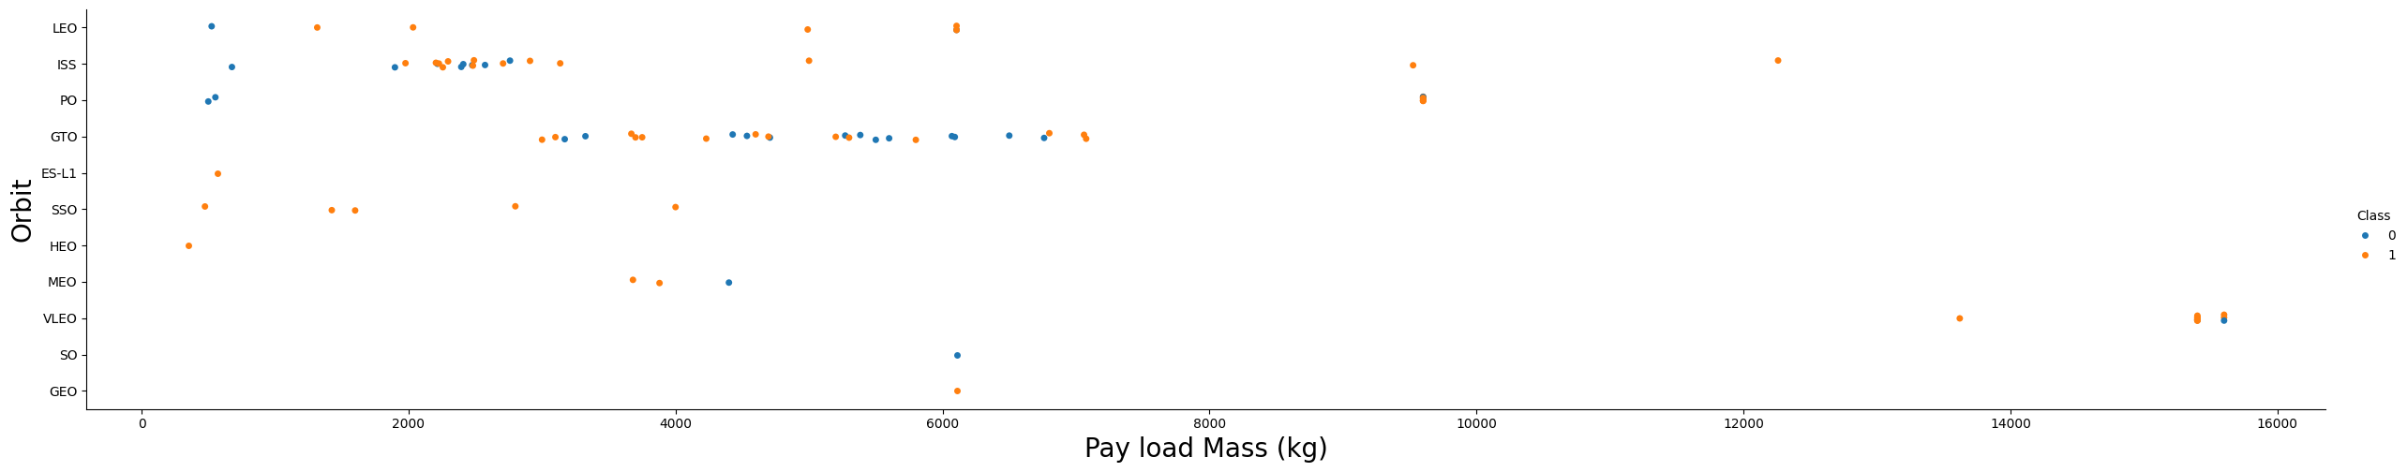
Payload vs. Orbit Type
The scatter plot highlights the relationship between payload mass and orbit type, providing valuable insights for mission planning and optimization.
Key Insights:
Heavier payloads are more likely to succeed in Polar, LEO, and ISS orbits.
GTO missions face challenges with heavier payloads, requiring further optimization for consistent success
LEO (Low Earth Orbit):
The plot shows a wide range of payload masses for LEO, with successful landings observed across both light and heavy payloads.
This indicates that LEO missions are versatile and capable of handling diverse payload requirements
GTO (Geostationary Transfer Orbit:
GTO missions tend to have moderate to heavy payloads.
The success rate appears mixed, with both successful and unsuccessful landings, suggesting challenges in achieving consistent success for heavier payloads in this orbit.
Polar and ISS Orbits:
These orbits show successful landings even with heavier payloads, indicating reliability for such missions.
Polar orbits, in particular, demonstrate a strong success rate for heavy payloads.
VAFB-SLC Launch Site:
- Notably, there are no launches with payloads exceeding 10,000 kg for this site, which may reflect specific mission constraints or capabilities

Slide 23
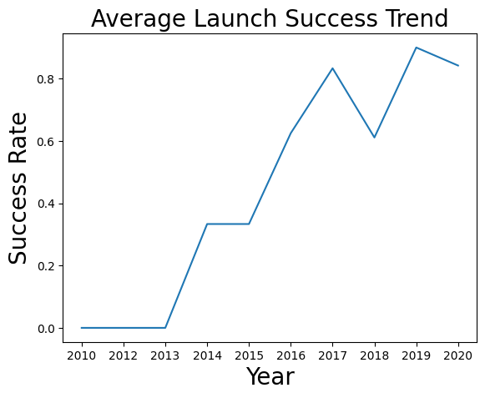
Launch Success Yearly Trend
The line chart illustrates the yearly trend in the success rate of SpaceX launches. Key observations include:
Initial Years (2010-2013): The success rate was 0%, indicating no successful landings during this period.
Gradual Improvement (2014-2016): Starting in 2014, the success rate began to improve, reaching 62.5% in 2016. This reflects SpaceX's growing experience and technological advancements.
Peak Performance (2017-2020): The success rate peaked in 2017 at 83.3% and remained consistently high in subsequent years, with 90% in 2019 and 84.2% in 2020. This demonstrates SpaceX's maturity in achieving reliable landings.
Overall, the chart highlights a clear upward trend in SpaceX's launch success rate, showcasing their continuous improvement and innovation over the years.

Slide 24
All Launch Site Names
Below are the list of all launch site names, along with the SQL query used to generate the results
Launch_Site
CCAFS LC-40
VAFB SLC-4E
KSC LC-39A
CCAFS SLC-40
Query:
%%sql
SELECT DISTINCT LAUNCH_SITE
FROM SPACEXTBL;

Slide 25
Launch Site Names Begin with 'CCA'
Below are the list of 5 records where launch sites begin with “CCA”, along with the SQL query used to generate the results
Five records of launch sites that begin with “CCA”:
Date | Time (UTC) | Booster_Version | Launch_Site | Payload | PAYLOAD_MASS__KG_ | Orbit | Customer | Mission_Outcome | Landing_Outcome
2010-06-04 | 18:45:00 | F9 v1.0 B0003 | CCAFS LC-40 | Dragon Spacecraft Qualification Unit | 0 | LEO | SpaceX | Success | Failure (parachute)
2010-12-08 | 15:43:00 | F9 v1.0 B0004 | CCAFS LC-40 | Dragon demo flight C1, two CubeSats, barrel of Brouere cheese | 0 | LEO (ISS) | NASA (COTS) NRO | Success | Failure (parachute)
2012-05-22 | 7:44:00 | F9 v1.0 B0005 | CCAFS LC-40 | Dragon demo flight C2 | 525 | LEO (ISS) | NASA (COTS) | Success | No attempt
2012-10-08 | 0:35:00 | F9 v1.0 B0006 | CCAFS LC-40 | SpaceX CRS-1 | 500 | LEO (ISS) | NASA (CRS) | Success | No attempt
2013-03-01 | 15:10:00 | F9 v1.0 B0007 | CCAFS LC-40 | SpaceX CRS-2 | 677 | LEO (ISS) | NASA (CRS) | Success | No attempt
The SQL query, which selects 5 records from the table SPACEXTBL where the launch_site value starts with “CCA”:
%%sql
SELECT *
FROM SPACEXTBL
WHERE LAUNCH_SITE LIKE 'CCA%'
LIMIT 5;

Slide 26
Total Payload Mass
The total payload carried by boosters from NASA is 45,596.
The query used to generate that result is the following and it calculates the total payload mass (in kilograms) carried by SpaceX missions where the customer is "NASA (CRS)." It uses the `SUM` function to aggregate the values in the `PAYLOAD_MASS__KG_` column, filtered by the condition `Customer = 'NASA (CRS)’`.
%%sql
SELECT SUM(PAYLOAD_MASS__KG_)
FROM SPACEXTBL
WHERE Customer = 'NASA (CRS)';

Slide 27
Average Payload Mass by F9 v1.1
The average payload mass carried by booster version F9 v1.1 is 340.4.
The following SQL query calculates the average payload mass (`PAYLOAD_MASS__KG_`) for all records in the `SPACEXTBL` table where the `Booster_Version` starts with the string `'F9 v1.0'`. The `LIKE` operator with the `%` wildcard is used to match any `Booster_Version` that begins with `'F9 v1.0'`. The result is returned as `AVGPAYLOADMASS`.
%%sql
SELECT AVG(PAYLOAD_MASS__KG_) as AVGPAYLOADMASS
FROM SPACEXTBL
WHERE Booster_Version like 'F9 v1.0%';

Slide 28
First Successful Ground Landing Date
The date of the first successful landing outcome on ground pad is 2015-12-22.
The following SQL query retrieves the earliest date (`MIN(Date)`) from the `SPACEXTBL` table where the `Landing_Outcome` is `'Success (ground pad)'`. The result is labeled as `FIRST_DATE`. It essentially identifies the first successful landing on a ground pad.
%%sql
Select MIN(Date) as FIRST_DATE
from SPACEXTBL
where Landing_Outcome = 'Success (ground pad)';

Slide 29
Successful Drone Ship Landing with Payload between 4000 and 6000
The names of boosters which have successfully landed on drone ship and had payload mass greater than 4000 but less than 6000 are the following:
F9 FT B1021.1
F9 FT B1022
F9 FT B1023.1
F9 FT B1026
F9 FT B1029.1
F9 FT B1021.2
F9 FT B1029.2
F9 FT B1036.1
F9 FT B1038.1
F9 B4 B1041.1
F9 FT B1031.2
F9 B4 B1042.1
F9 B4 B1045.1
F9 B5 B1046.1
The following SQL query retrieves a list of unique booster versions from the `SPACEXTBL` table that meet two specific criteria: 1. Landing Outcome: The booster must have successfully landed on a drone ship (`'Success (drone ship)'`).
2. Payload Mass: The payload mass carried by the booster must be greater than 4000 kg and less than 6000 kg. The `DISTINCT` keyword ensures that only unique booster versions are returned, avoiding duplicates in the result.
%%sql
SELECT DISTINCT BOOSTER_VERSION
FROM SPACEXTBL
WHERE LANDING_OUTCOME = 'Success (drone ship)'
and 4000<PAYLOAD_MASS__KG_<6000;

Slide 30
Total Number of Successful and Failure Mission Outcomes
Below is the total number of successful and failure mission outcomes
Mission_Outcome | TOTAL_NUMBER
Failure (in flight) | 1
Success | 98
Success | 1
Success (payload status unclear) | 1
This SQL query retrieves the count of each unique mission outcome from the `SPACEXTBL` table.
- `MISSION_OUTCOME`: Represents the result of each mission (e.g., success or failure).
- `COUNT(MISSION_OUTCOME)`: Counts how many times each mission outcome appears in the table.
- `GROUP BY MISSION_OUTCOME`: Groups the data by each unique mission outcome to calculate the count for each group.
The result is a summary showing the total number of missions for each outcome type.
%%sql
SELECT MISSION_OUTCOME, COUNT(MISSION_OUTCOME) as TOTAL_NUMBER
from SPACEXTBL
group by MISSION_OUTCOME;

Slide 31
Boosters Carried Maximum Payload
Here are the names of the booster which have carried the maximum payload mass:
The following query retrieves the distinct booster versions that carried the maximum payload mass from the `SPACEXTBL` table.
- The inner query (`SELECT MAX(PAYLOAD_MASS__KG_) FROM SPACEXTBL`) finds the maximum payload mass in the table.
- The outer query filters rows where the payload mass matches this maximum value and selects the distinct booster versions associated with those rows.
%%sql
SELECT DISTINCT BOOSTER_VERSION
FROM SPACEXTBL
WHERE PAYLOAD_MASS__KG_ = (
SELECT MAX(PAYLOAD_MASS__KG_)
FROM SPACEXTBL);
Booster_Version
F9 B5 B1048.4
F9 B5 B1049.4
F9 B5 B1051.3
F9 B5 B1056.4
F9 B5 B1048.5
F9 B5 B1051.4
F9 B5 B1049.5
F9 B5 B1060.2
F9 B5 B1058.3
F9 B5 B1051.6
F9 B5 B1060.3
F9 B5 B1049.7

Slide 32
2015 Launch Records
Below are the failed landing_outcomes in drone ship, their booster versions, and launch site names for in year 2015:
Landing_Outcome | Booster_Version | Launch_Site
Failure (drone ship) | F9 v1.1 B1012 | CCAFS LC-40
Failure (drone ship) | F9 v1.1 B1015 | CCAFS LC-40
The following SQL query retrieves specific columns (`LANDING_OUTCOME`, `BOOSTER_VERSION`, and `LAUNCH_SITE`) from the `SPACEXTBL` table. It filters the results to include only rows where:
The `LANDING_OUTCOME` is `'Failure (drone ship)'`.
The year extracted from the `DATE` column is `'2015'` (using the `strftime('%Y', DATE)` function to extract the year).
The query essentially lists all failed drone ship landings in 2015, along with the associated booster versions and launch sites.
%%sql
SELECT LANDING_OUTCOME, BOOSTER_VERSION, LAUNCH_SITE
FROM SPACEXTBL
WHERE LANDING_OUTCOME = 'Failure (drone ship)'
AND strftime('%Y', DATE) = '2015';

Slide 33
Rank Landing Outcomes Between 2010-06-04 and 2017-03-20
The table below ranks the count of landing outcomes (such as Failure (drone ship) or Success (ground pad)) between the date 2010-06-04 and 2017-03-20, in descending order:
The following query retrieves the count of each unique LANDING_OUTCOME for SpaceX missions that occurred between the dates '2010-06-04' and '2017-03-20'. It groups the results by LANDING_OUTCOME, calculates the total count for each outcome, and orders the results in descending order of the count.
%%sql
SELECT LANDING_OUTCOME, COUNT(LANDING_OUTCOME) AS TOTAL_NUMBER
FROM SPACEXTBL
WHERE DATE BETWEEN '2010-06-04' AND '2017-03-20'
GROUP BY LANDING_OUTCOME
ORDER BY TOTAL_NUMBER DESC
Landing_Outcome | TOTAL_NUMBER
No attempt | 10
Success (drone ship) | 5
Failure (drone ship) | 5
Success (ground pad) | 3
Controlled (ocean) | 3
Uncontrolled (ocean) | 2
Failure (parachute) | 2
Precluded (drone ship) | 1

Slide 34

Section 3

Slide 35
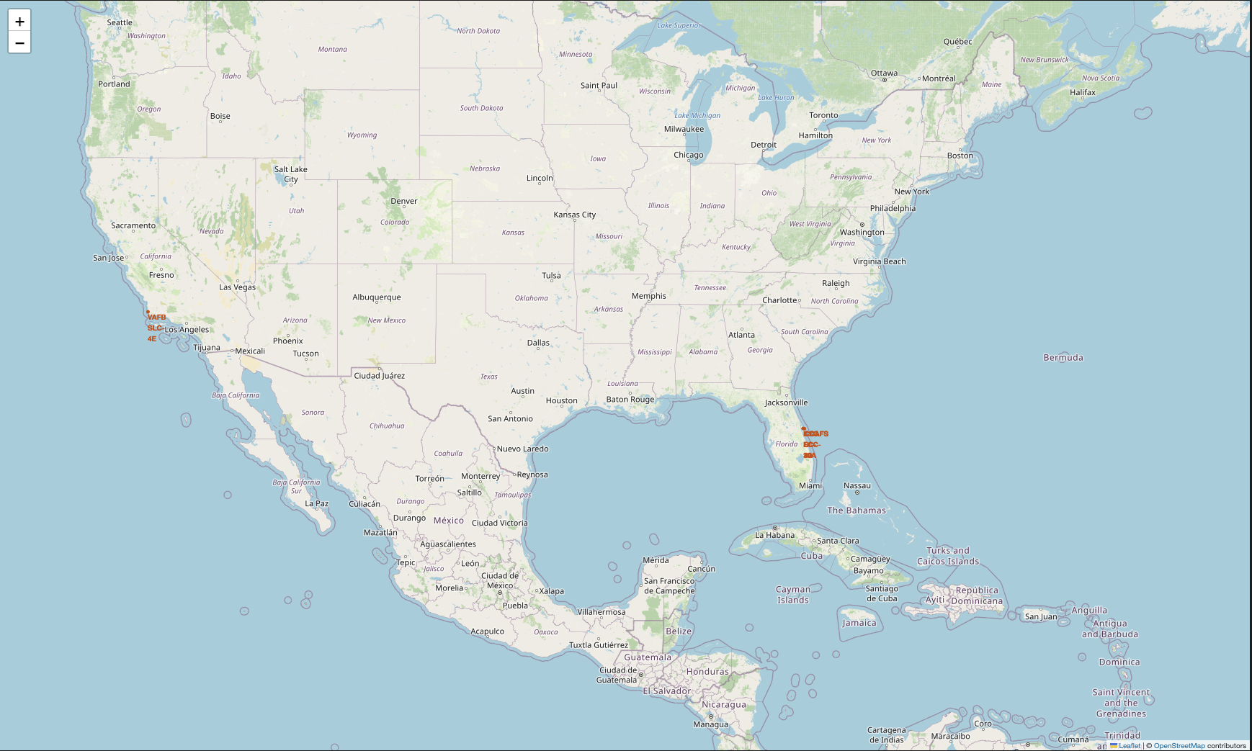
Launch Site Locations
Key Elements:
Markers placed at the four major SpaceX launch sites:
KSC LC-39A (Florida)
CCAFS SLC-40 (Florida)
VAFB SLC-4E (California)
SpaceX LC-4 (Texas)
Popups or labels may indicate launch site names for quick reference.
The zoom level is adjusted to capture all sites on a single world map view.
Key Findings:
Launch sites are strategically located along the U.S. coastline, likely for safety and trajectory advantages over oceans.
Two sites are clustered in Florida, highlighting the region's importance for missions.
Visualizing locations globally shows geographic distribution and reinforces SpaceX’s preference for U.S.-based launches.

Slide 36
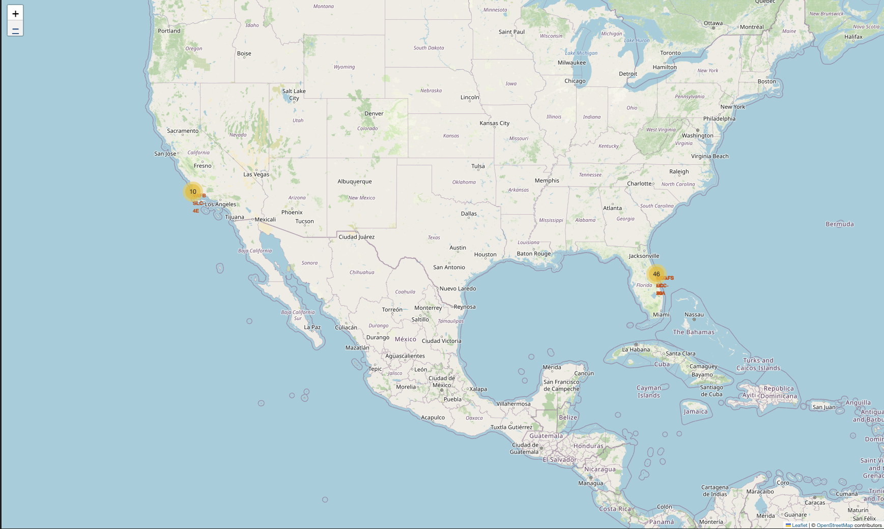
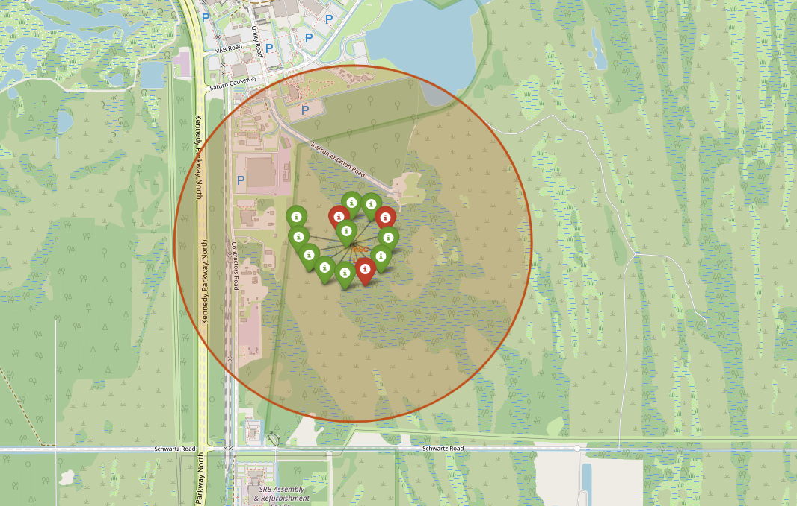
Launch Outcomes by Location (Success vs Failure)
Key Elements on the Map:
Color-coded markers represent launch outcomes:
Green for successful launches (class = 1)
Red for failed launches (class = 0)
Each marker is placed at the corresponding launch site’s coordinates for each recorded launch.
Popups or tooltips may show mission details (e.g., site name, payload, outcome).
Key Findings:
Most launches are successful, indicated by the dominance of green markers.
A few red markers highlight rare failures, helping pinpoint where and how often they occur geographically.

Slide 37
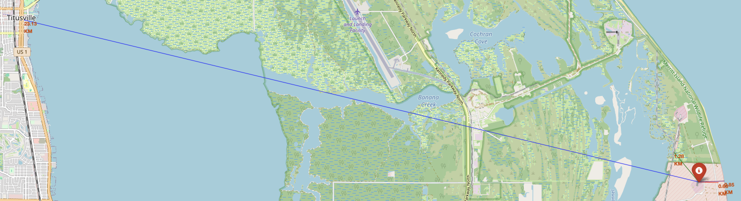
<Folium Map Screenshot 3>
Important Elements on the Map:
Launch Site Marker: Clearly labeled marker for the selected SpaceX launch site (e.g., LC-40).
Lines with Distance Annotations:
To Railway: Line from the launch site to the nearest railway, showing the distance.
To Highway: Line to the nearest major highway or road.
To Coastline: Line to the closest point along the Atlantic coastline.
Measurement Popups: Popups showing the distance in meters/kilometers for each proximity line.
Base Map Context: The surrounding geography and infrastructure to show strategic placement.
Key Findings:
The launch site is within close proximity to major infrastructure, which is crucial for logistics, transportation of rocket components, and emergency response.
For example:
Highway: ~0.66 km away – ensures easy ground transport access.
Railway: ~1.28 km – may support heavy freight delivery.
City: ~23.13 km from Titusville - far away for public safety
Water: ~0.85 km from Cape Carnival - close for launch purposes
The strategic coastal location minimizes population risk and supports orbital trajectory over the ocean.

Slide 38

Section 4

Slide 39
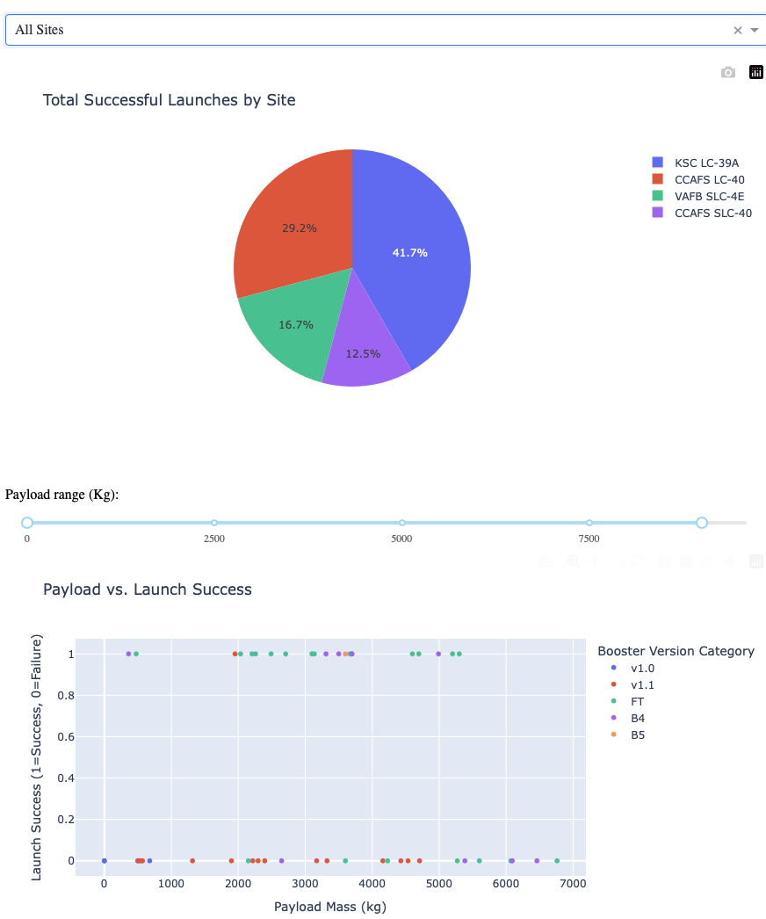
Distribution of Successful Launches by Site
The pie chart displays the total count of successful SpaceX launches across all launch sites. Each slice corresponds to a specific launch site, and its size reflects the number of successful launches from that site. From the chart, we can see that KSC LC-39A has the highest number of successful launches, indicating it is the most reliable or frequently used launch site. This visual summary allows quick comparison of launch success across sites. The dashboard interaction enables drilling down further by selecting a specific site to view detailed success vs failure rates.
In addition, the scatterplot below shows the relationship between payload mass and success rates for all sites and by Booster Version Category.

Slide 40
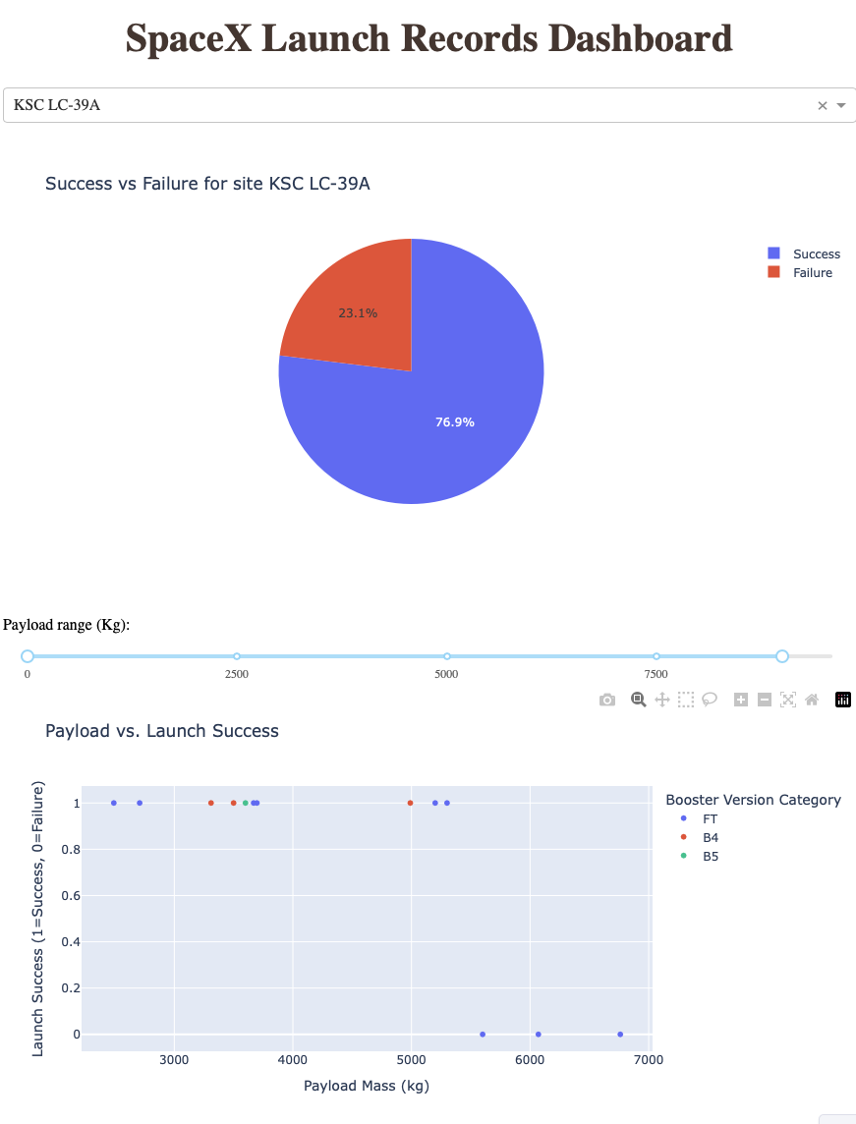
Launch Outcome for Site KSC LC-39A
Explanation of Pie Chart (for KSC LC-39A)
Slices: The pie chart shows two slices representing:
Successes (class = 1): Number of successful launches from KSC LC-39A.
Failures (class = 0): Number of failed launches from KSC LC-39A.
Slice size: Proportional to how many launches succeeded or failed at this site.
Insight: This breakdown reveals the reliability of the KSC LC-39A launch site. For example, a larger success slice means most launches from this site succeeded, indicating high reliability. Conversely, a sizable failure slice would suggest some risk or issues with launches from this site.
Explanation of Scatter Plot (for KSC LC-39A)
Axes:
X-axis: Payload Mass (kg) — shows the weight of the payload carried on the launch.
Y-axis: Launch Success (class), where 1 means success and 0 means failure.
Points: Each point represents a launch from KSC LC-39A within the selected payload mass range.
Color: Points are colored by Booster Version Category, helping identify if certain booster types correlate with success or failure.
Insights:
You can see if higher or lower payload masses tend to correspond with successful launches.
You may identify clusters of successes or failures linked to specific booster versions.
For example, if all failures cluster at higher payload masses or a specific booster type, this might indicate a risk factor.
Summary
Together, these plots help analyze:
The overall success rate at KSC LC-39A (pie chart).
How payload mass and booster version relate to launch success at this site (scatter plot).
This lets users explore the performance and risks of the site in detail.

Slide 41
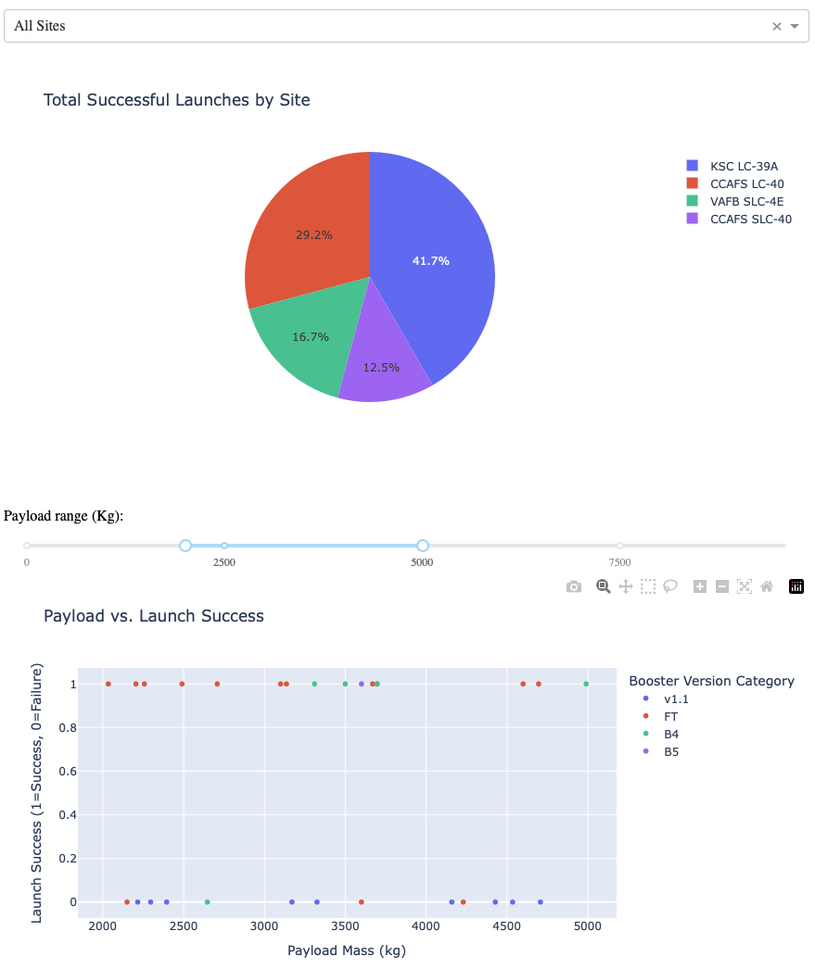
Payload vs Launch Success for All Sites, and payload between 2500 and 5000
Key Elements:
X-axis: Payload Mass (kg)
Y-axis: Launch Outcome (0 = Failure, 1 = Success)
Color: Booster Version Category
Insights:
Most launches in this payload range are successful (class = 1).
Booster versions like FT and v1.1 show strong success patterns.
No clear trend of failure at payload extremes — medium payloads are reliably launched.

Slide 42

Section 5

Slide 43
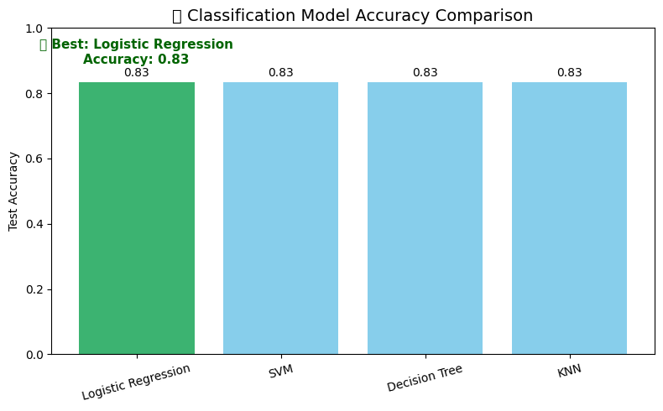
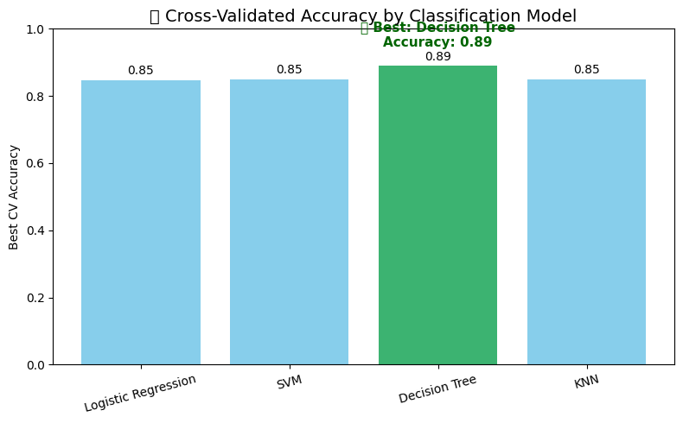
Classification Accuracy
The test accuracy of all four classification models was visualized. All models performed identically due to relatively low sample size. We compared models using 10-fold cross-validation. The highest cross-validated accuracy was achieved by Decision Tree at 89%.
The charts below shows the test accuracy and best cross-validation accuracy (best_score_) for each classifier.

Slide 44
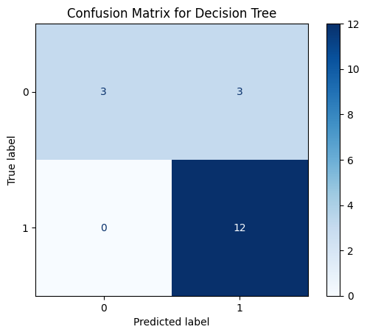
Confusion Matrix – Decision Tree
The matrix illustrates how well the model distinguishes between the different classes:
True Positives & True Negatives (diagonal values) indicate correct predictions.
False Positives / False Negatives (off-diagonal) show misclassifications.
Most errors came from classifying X as Y (e.g., false positives).
Overall, the model shows strong classification accuracy with relatively low misclassification rates.

Slide 45
Conclusions
Data was extracted using the SpaceX REST API and enhanced through web scraping with BeautifulSoup, providing rich information on launches and payloads.
Exploratory analysis included interactive visualizations using Folium maps for launch site outcomes and Plotly dashboards for mission success metrics.
Data preprocessing involved standardization and feature engineering, ensuring robust input for model training.
Built and optimized Logistic Regression, SVM, Decision Tree, and K-Nearest Neighbors using GridSearchCVwith 10-fold cross-validation.
All models yielded some confident results, with Decision Tree having slightly higher cross validation accuracy.
Confusion matrices for all models highlight strong class separation, although false positives persists.

Slide 46
Appendix
Include any relevant assets like Python code snippets, SQL queries, charts, Notebook outputs, or data sets that you may have created during this project

Slide 47


